Slide 1
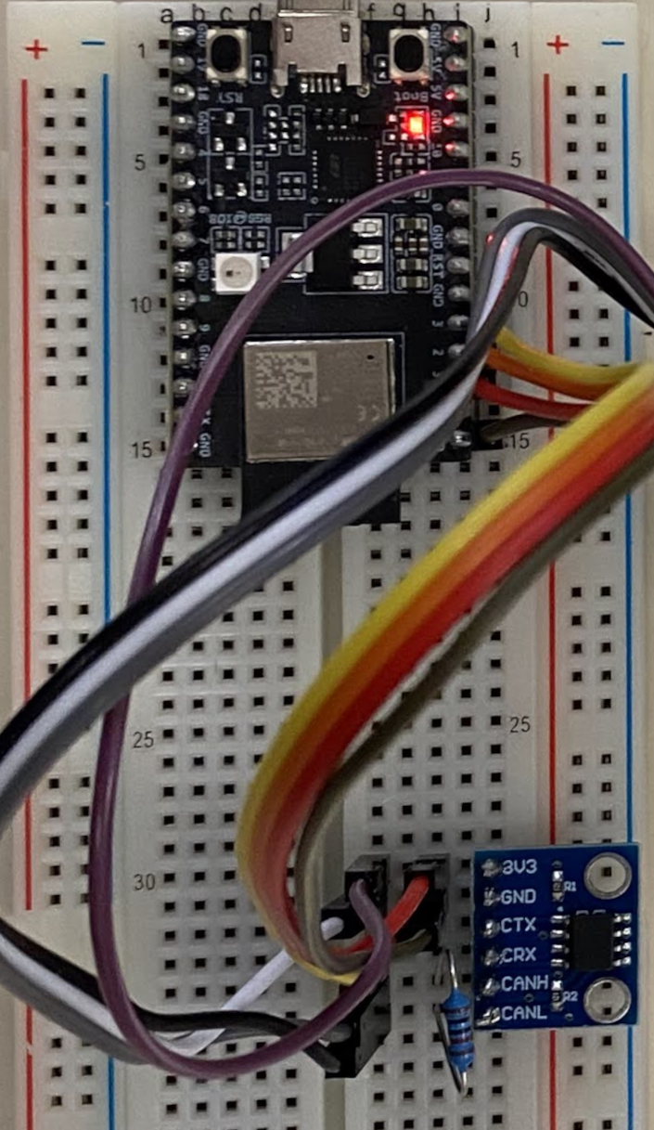
NuttX RTOS CAN Bus Driver for Espressif ESP32C3
Faculty of Electrical Engineering
Jan Charvát
Supervisor – Ing. Pavel Píša, PhD.
16.6.2022

Slide 2
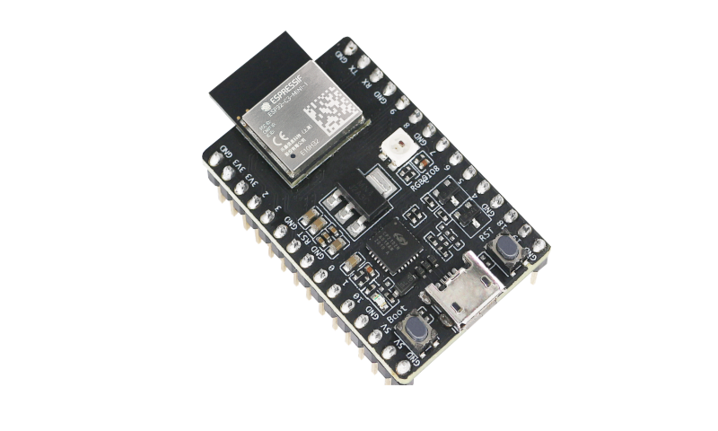
Introduction
NuttX CAN subsystem analysis on ESP32C3
Implementation of CAN (TWAI) driver
Testing and demonstration of driver functionality
Notes:
Espressif uses Two Wire Automotive Interface because of trademark, configurable GPIO

Slide 3
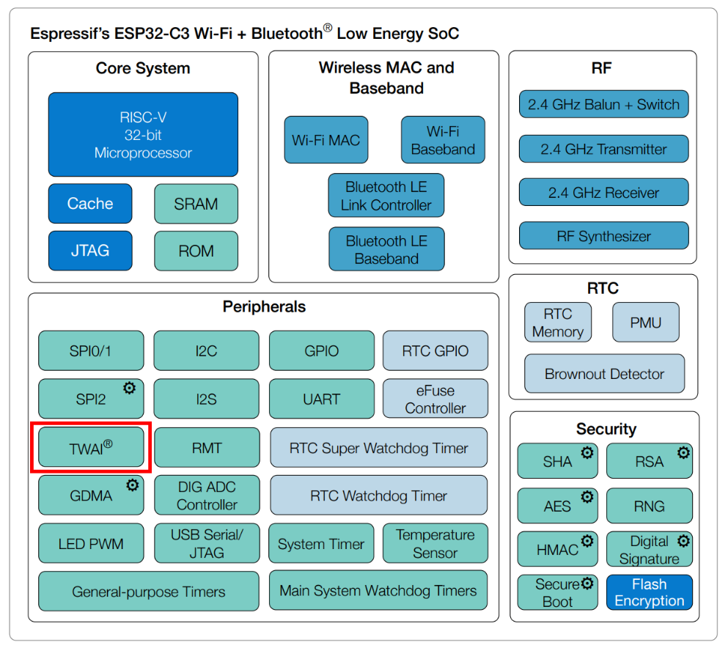
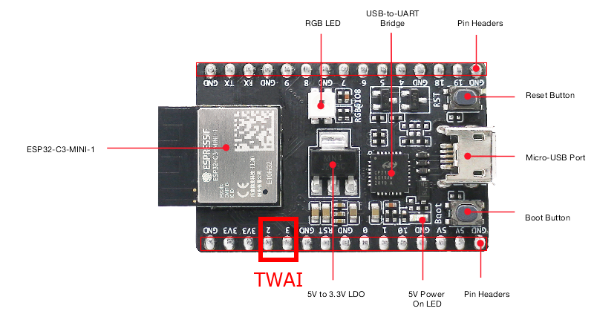
ESP32C3 DevKit
RISC-V single-core
microcontroller
Wi-Fi & Bluetooth 5 (LE) module
SJA1000 CAN 2.0 controller
Notes:
Advantages- cheap, many GPIOs & peripherals, frequency 160 MHz, public lighting of the city of Milan, using SJA1000 opencore
Red rectangle TWAI and 2,3 pins mapped CAN

Slide 4
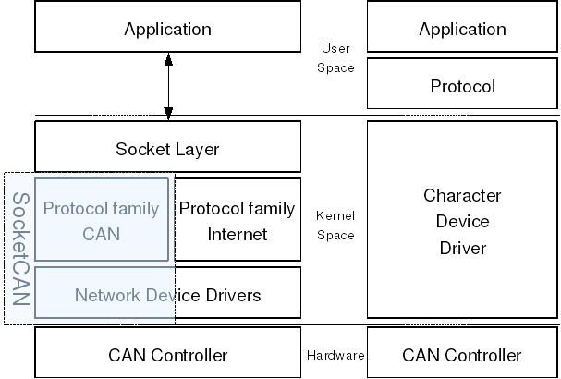
NuttX CAN subsystem
Open-source RTOS
Character Device Driver
“lower” half driver
Notes:
Higher – Generic part, Lower – architecture-specific – my implementation, comparison with SocketCAN, but in NuttX mostly implemented character device driver, also it has better performance on small chips
Shorter – SocketCAN or Character Device Driver – say HW dependent and HW independent

Slide 5
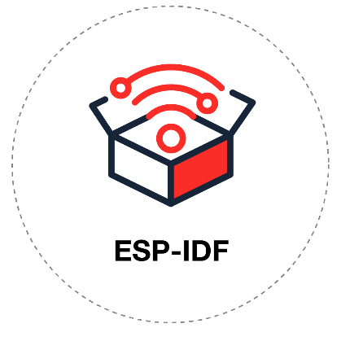
Related work
ESP-IDF TWAI
Official Espressif framework
LinCAN
SJA1000 support
Thorough bit timing solutions
NXP lpc17-40 CAN
NuttX CAN implementation
Notes:
LinCAN bit timing later used in SocketCAN
For the beginning I use ESP IDF for functionality test and then as inspiration
LinCAN for Linux – inspiration for bit timing in SocketCAN

Slide 6
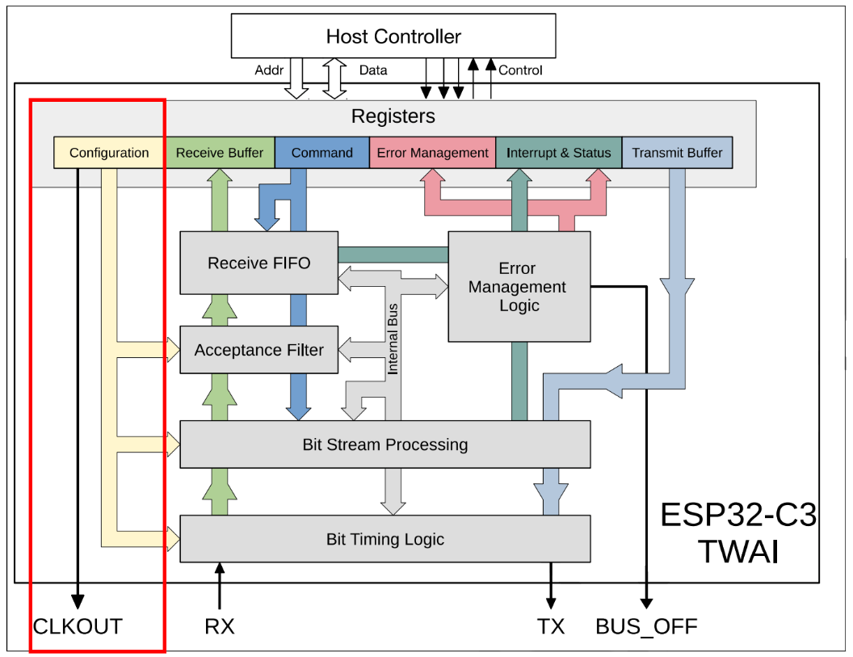
TWAI initialization
Power and clock
enabled,
pins configuration
Reset TWAI device – different register layout
Error counters, Bit timing
Acceptance filters
Setup interrupts
Notes:
After system boot, 13 DATA registers
RESET – for parameter setting is changed controller to RESET mode and it changes possibility to modify some registers and change 13 DATA registers

Slide 7
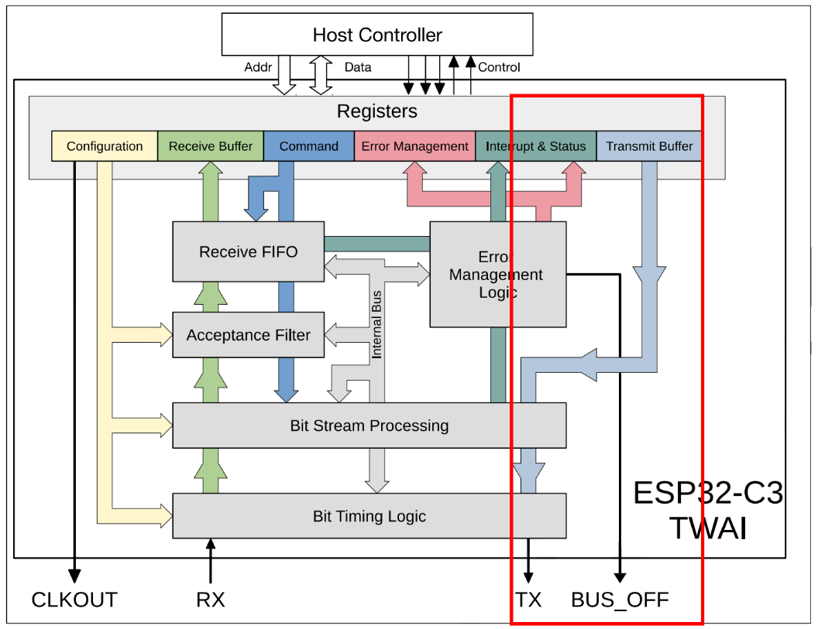
TWAI Transmission
Single TX buffer
Upper driver holds SW TX FIFO
Modes for transmission
Loopback mode
Standard mode
Support for extended IDs
Notes:
Go straightforward to point – low level controller writes to DATA registers, two modes, self reception and standard regime

Slide 8
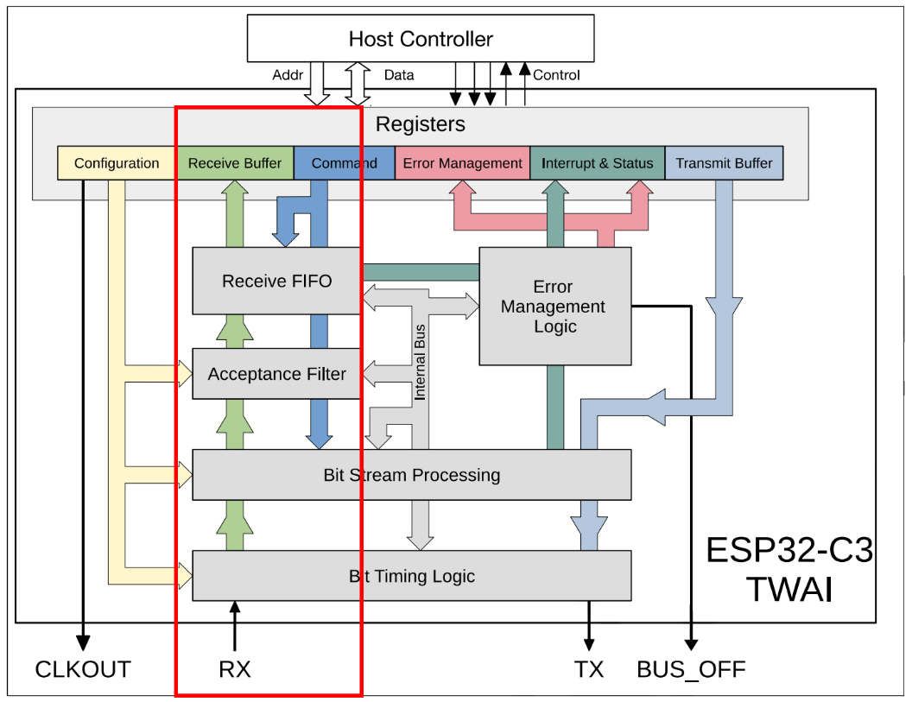
TWAI Reception
RX interrupts
RX buffer – first received frame mapped on DATA registers
Support for extended IDs
Notes:
Controller receives to HW FIFO and informs to data received by interrupts

Slide 9
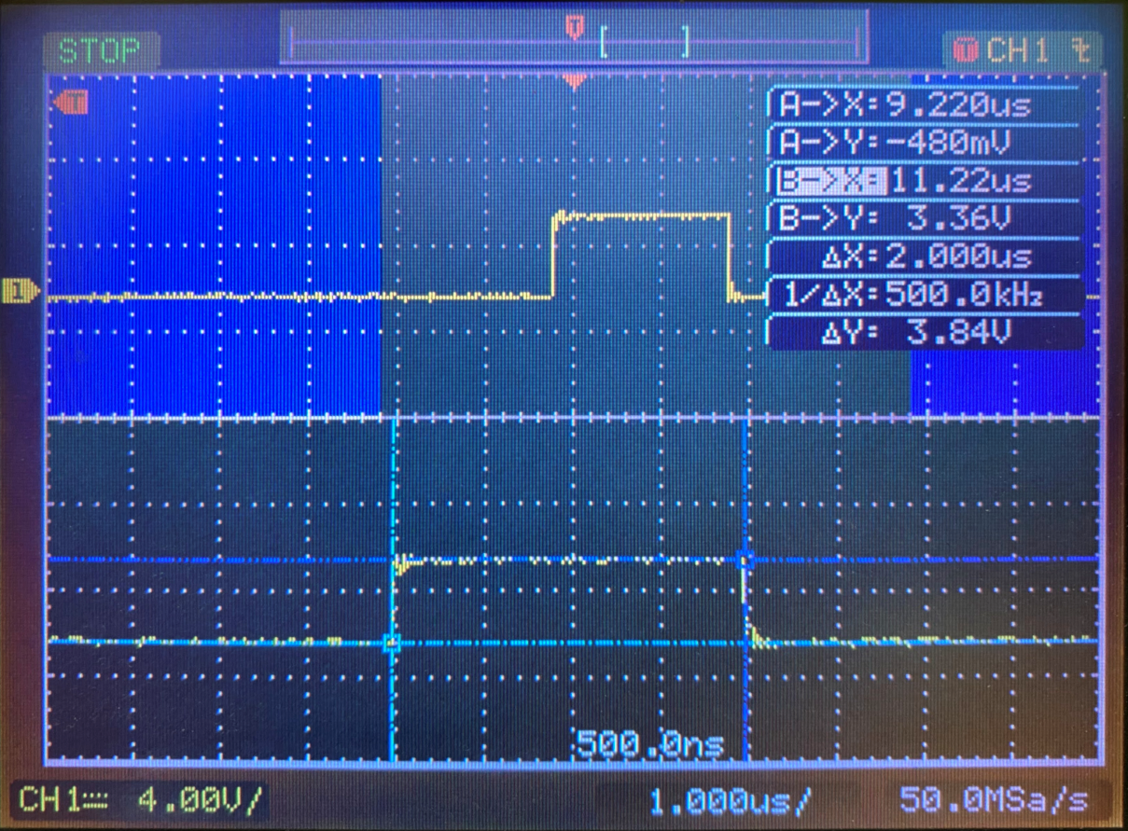
Testing
Bit timing
Linux CAN utils
Latency Tester
Timing Analysis of a Linux-Based CAN-to-CAN Gateway
Matěj Vasilevski contribution
Motor control application in pysimCoder
Notes:
Verified bit timing on oscilloscope, next was against implementation of CAN on system on Linux and proper testing with latency tester
Colleague works on contribution to Latency tester

Slide 10
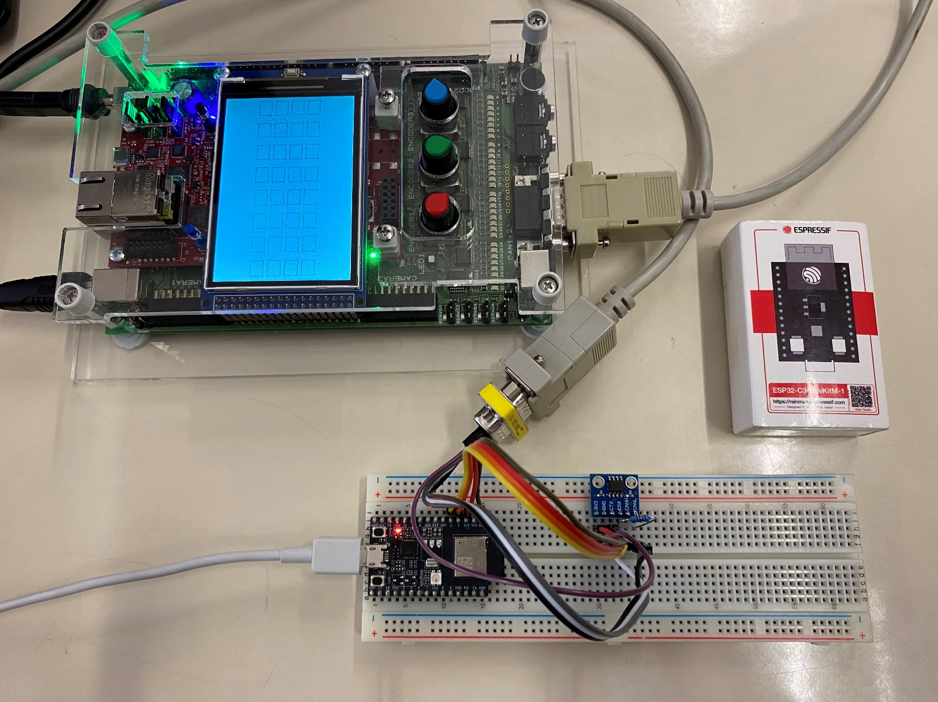
Linux CAN utils

Slide 11
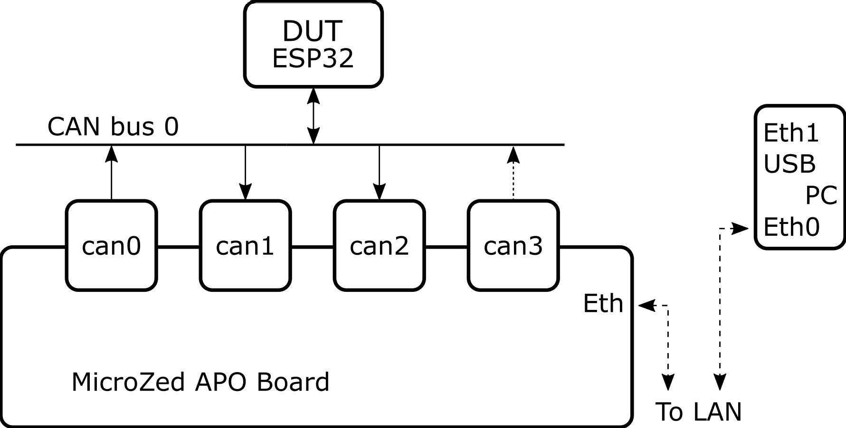
Latency Tester
Notes:
Channel both-directinal, different ID for higher priority

Slide 12
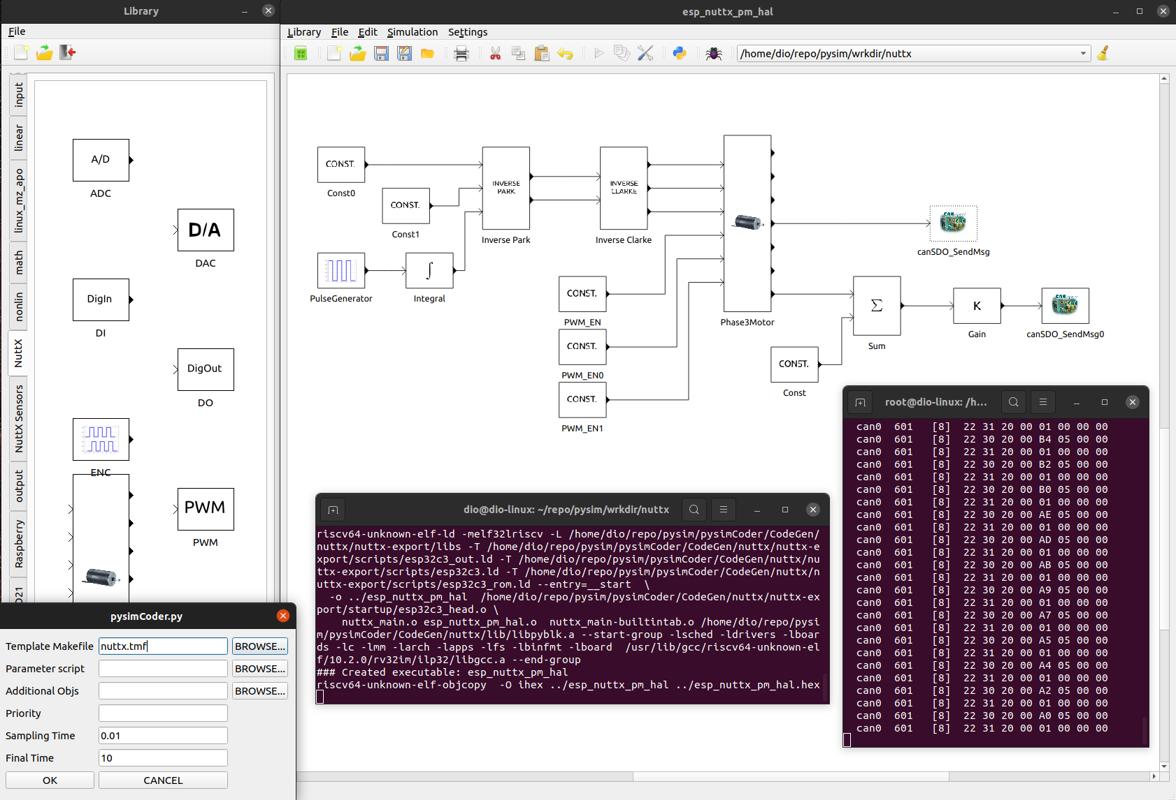
Motor control in pysimCoder
Notes:
Experiment with pysimCoder and data transfer is visible

Slide 13
Conclusion
Driver integration completed
TWAI (CAN) support has been added to NuttX mainline
https://github.com/apache/incubator-nuttx/pull/6005
At Espressif Alan C. Assis ported to Xtensa ESP32
Successful demonstration of functionality
Future work
Implement rest of IOCTL calls
Restore from overflow
Notes:
In normal use no RX overflow occurs, but in simulated RX overflow I tried implementation depending on manual, but it does not work
Pull request

Slide 14
Thank you for your attention
Faculty of Electrical Engineering
Jan Charvát
16.6.2022

Slide 15
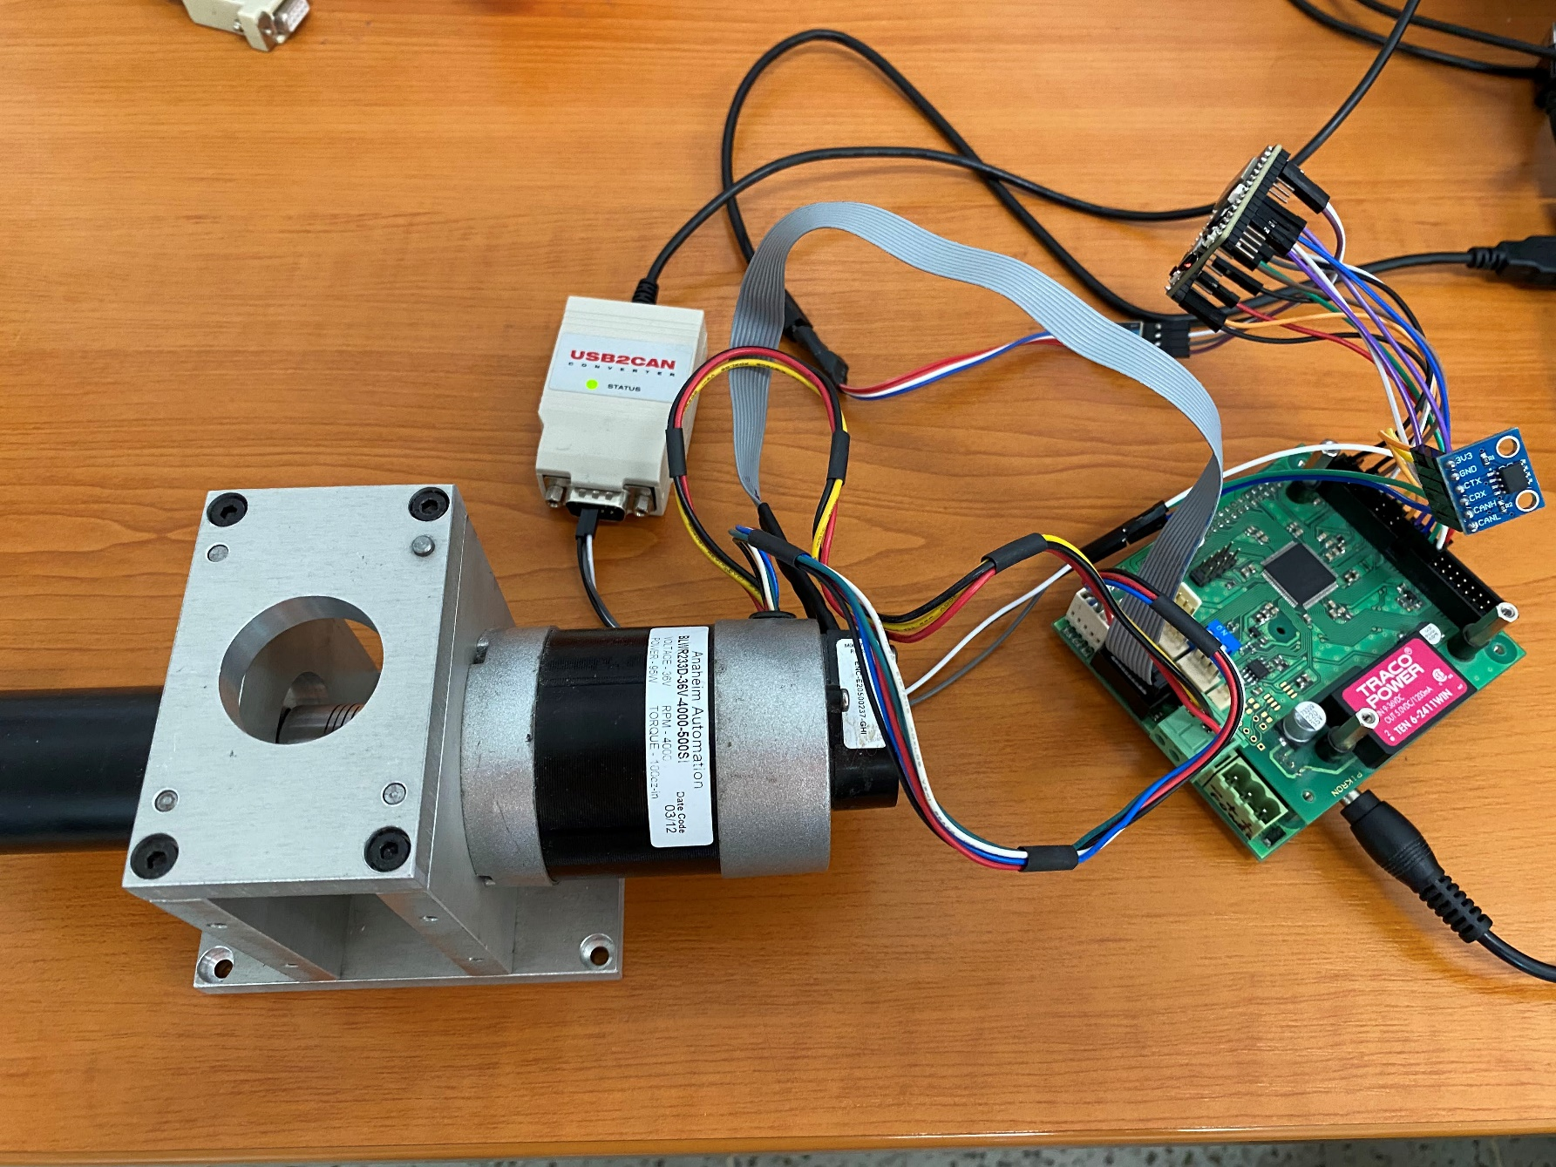
Notes:
Illustrative example

